Slide 1

Control Chart Pattern Recognition Using Convolutional Neural Network
Sumit Gaurav
Sarthak Taunk

Slide 2
Why we use control charts to analyze production quality
The application of statistical process control has promoted production quality improvement of many enterprises, and as core tool of SPC, Control chart is used to reflect the production state. In addition to normal pattern, abnormalities in the production process can be summarized in seven basic control chart patterns(CCPs). And recognition and analyzation of CCPs is helpful to identify quality failures and find root abnormal causes in time.

Slide 3
Introduction
Product Quality is a key factor in the market competition of enterprises, and to check the production quality and promote improvement we use statistical process control.
The fundamental idea of SPC is to use mathematical statistics methods to monitor various stages of product process.
As a core tool of SPC, Control chart is used to reflect the production state.

Slide 4
The 8 basics patterns of control charts are:
1. Normal Pattern(NOR): The normal pattern indicates the production process in-control.
2. Systematics Pattern(SYS): The systematic pattern appears as a high point always follow a low pointy and vice-versa. So the point-to-point fluctuations can be predicted.
3.Stratification Pattern(STR): This show that the data is more concentrated and variance of data becomes smaller.

Slide 5
4. Cyclic pattern: Periodic occurrence of peaks and troughs can be found in cyclic pattern.
5. Trend pattern: In trend patterns, the data shows a continuous rise or fall, named upward trend and downward trend respectively.
6. Shift pattern: The shift patterns appear as a sudden rise or fall in the mean of data, named upward shift and downward shift respectively.

Slide 6
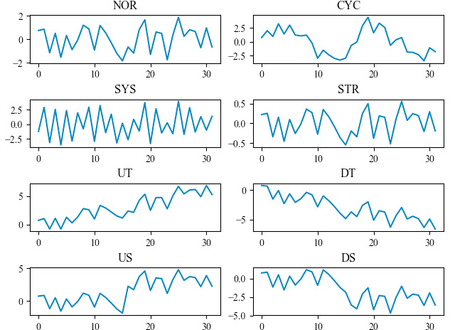
Basic control chart patterns.

Slide 7
Related Work
Many methods have been applied to the recognition of control chart patterns (CCP)s.Some methods directly feed the raw CCPs data into the recognition model, while others first use statistical knowledge to extract features from raw data, such as mean square amplitude, standard deviation, peak, average, etc.
there are lots of different features that can be constructed, making it a challenge to select the appropriate feature subset so as to reduce the computational complexity and improve the classification accuracy of the model.
some dimension reduction methods such as independent component analysis and principal component analysis are used to reduce redundancy between features.

Slide 8
After determining the input form of data, whether it is raw data or extracted feature data, a model will be built to realize accurate recognition of different CCPs.
Some classical methods such as fuzzy inference system (FIS), support vector machine (SVM), artificial neural network (ANN) have been applied in CCPs recognition systems.
Based on existing researches, it can be found that the CCPs recognition method based on feature extraction usually have better performance.

Slide 9
Why do we use Deep Learning
Deep learning establishes a mapping from inputs to outputs by a network structure.As a multi-level representation learning method, the deep learning model is composed by simple but non-linear modules of which can transform a lower level representation to a higher and slightly more abstract level representation.There are many typical deep learning methods such as deep belief network (DBN), deep neural network (DNN), convolutional neural network (CNN), recurrent neural network (RNN) and etc.The literatures above show that CNN can extract features from raw data and has great advantages in the processing of complex classification problems.

Slide 10
Data Simulation
Data simulation technology is the most widely used method in the field of recognition of CCPs.
With the automatic production capacity, enterprises have accumulated a lot of data but it is difficult to train models with these data as it takes lot of efforts to classify and label the data.
Once data of in control process have been collected we can obtain informations like distribution, mean estimate and variance estimatr of data

Slide 11
Then Data simulation process can be carried out to generate data of various pattern.
In this paper Monte Carlo Method is used for data simulation and Table 1 shows the formulas and parameters of simulation process:
𝜇 and 𝜎 are the mean and standard deviation estimate of the controlled production process.
𝑟(𝑡) represents the inevitable accidental fluctuation which subject to gaussian distribution 𝑁(0,1).

Slide 12
𝑑 indicates the degree of system state departure.
𝑎 is the amplitude of cyclic pattern.
𝑇 is the period of the cycle.
𝑔 is the gradient of data trend.
𝑃 represents the time point when the shift anomaly occurs.
𝑠 is the amplitude of shift pattern.
The sequence length of simulation data ‘L’ should not be too long, because longer window width od data means larger lag of anomaly recognition.
Generally window length is set to be “16-64” sampling points.

Slide 13
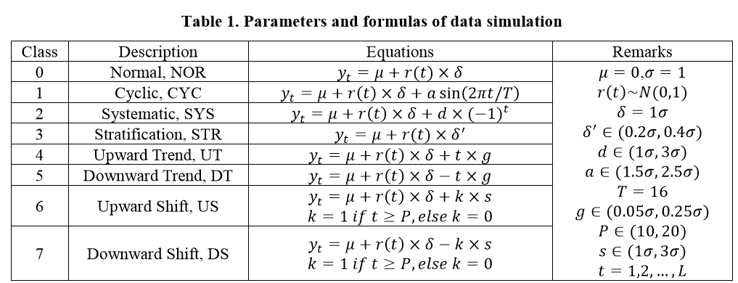

Slide 14
Methods
A brief introduction to CNN
The structure of CNN can be divided into two parts, The first part is composed of convolutional layers and pooling layers to realize feature extraction, and the second part is composed of full connection layers for final classification.
Each convolutional layer contains several filters to extract local features from the feature maps of previous layer, respectively, and followed by an activation unit to generate the output feature maps

Slide 15
The pooling layer is usually set after the convolutional layer, which is used to reduce the size of extracted feature maps. Max pooling and average pooling are two most widely used pooling methods
The fully connected layer and the softmax layer are usually set at the end of network structure to output the probability that the input sample belongs to each category

Slide 16
Architecture of Improved 1D-CNN
The first layer of the network is an input layer,The length of simulation layer is set to 32 which means that the dimension of input layer is 32.
Next comes a triple parallel convolutional module, known as INCEPTION,the filter size of three parallel convolutional structures are 1*1, 1*3, 1*5 respectively. And the stride of the filters in each row structure is “1” and the no. of filters is 5.

Slide 17
Then all the features maps obtained in “Inception” layer need to be concatenated and to be fed into average pooling layer.
Feature maps obtained after pooling are fed into next convolutional layer which has 10 filters of size 1*1 and stride is 1.
The another pair of average pooling layer and conv. Layer with same parameters is followed.

Slide 18
The ‘Activation function’ used in convolutional layer is rectified linear units (RELU) function to achieve faster convergence rate rather than other activation function.
The feature extracted from raw data using convolutional and pooling layers are then flatten by flatten layer so that feature maps can be fed into the fully connected layer.

Slide 19
And the end the Softmax function is used as activation function of Output layer to implement multi-category output.
Note: Filters of different sizes can extract multi-scale information from raw data, if same input is fed into three parallel convolutional structure, the size of output feature map will be different because of different filters, therefore Padding are needed to keep the output in the same size.

Slide 20
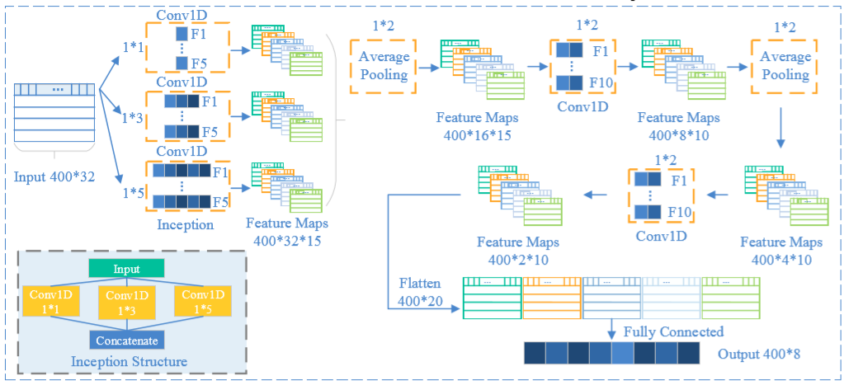
Architecture of the improved 1D-CNN model

Slide 21
Experiments
Two experiments are carried out to verify the effectiveness of improved 1D-CNN model for CCPs recognition:
The recognition effect for different models are compared in experiment 1
The generalization performance of improved 1D-CNN is tested in experiment 2.

Slide 22
Experiment 1: Recognition effects of different models.
The data of 8 kinds of CCPs used in the experiment are generated by the simulation method, each sample length are 32, and 500 pieces of each pattern are generated of which 350 used as training datasets, 50 used as validation datasets and 100 used as testing datasets.
Considering the randomness of data simulation, the experiment are repeated for 30 times to obtained average recognition accuracy of each model
Here 5 models are used for CCPs recognition that are ANN, 1L-1D-CNN, 2L-1D-CNN, 3L-1D-CNN amd improved 1D-CNN and check the recognition accuracy by testing each model .

Slide 23
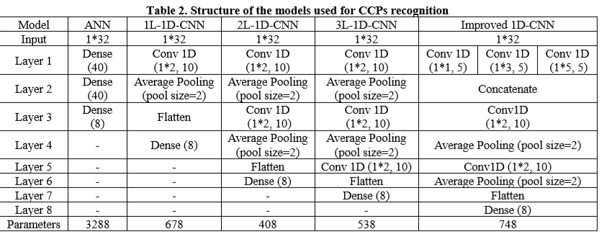

Slide 24

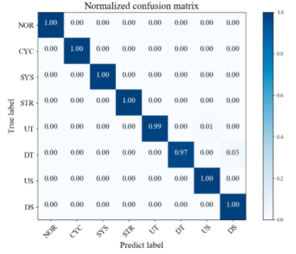
Confusion matrix of improved 1D-CNN

Slide 25
Experiment 2: Generalization performances of Improved 1D-CNN
Even huge amounts of data obtained, there must be deviation between the estimated value and true vale.
Therefore experiment is carried out to measure the generalization ability of models when mean and standard deviation of train and test data are inconsistent.
According to data simulation method, 500 pieces of data are generated for each CCP and then generating parameters of data used for model training are set unchanged i.e estimated mean=0 and estimated standard deviation=1.
While the mean value of test data is set -0.5 to 0.5 and for standard deviation it is set to 0.5 to 1.5 with interval of 0.1 for both cases.

Slide 26
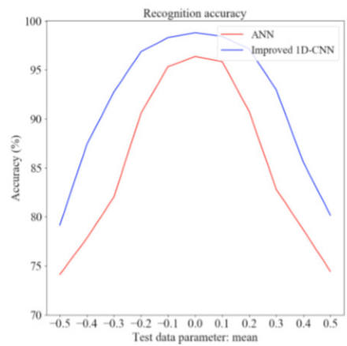
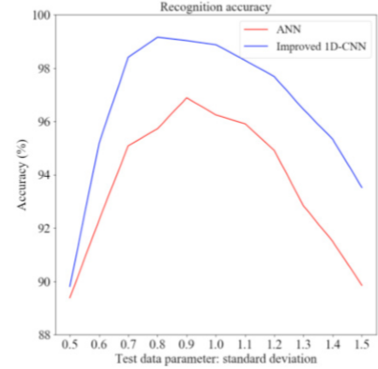
Recognition accuracy of improved 1D-CNN and ANN when the standard deviation and mean of training data and test data are inconsistent

Slide 27
30 times repeated tests are implemented for different combination of parameters to get average accuracy of CCPs recognition.
The showed in previous slide indicate that when test data and training data distribution are inconsistent, the prediction accuracy of the kodel will inevitably decreases.
However, the prediction accuracy of the improved 1D-CNN is significantly better than that of ANN.

Slide 28
Conclusions
Improved 1D-CNN achieved an average accuracy of 98.96% on the simulation datasets after 30 repeated test.
The result shows that CNN with an introduction of “Inception” structure achieves higher recognition accuracy than purely layer-by-layer CNN.
The Improved 1D-CNN model also has better generalization ability when there is an error between estimated value and true value for mean and standard deviation of train and test data.

